Slide 1

Fraud Alert use case - Machine Learning
- Penske Rockers team

Slide 2
Penske Rockers – Team members
Indhu Rajasekaran – Manager, Penske – RentalNet, MALS ADM Service Line
Skills – Java/J2EE, Oracle PL/SQL, C++, Shell scripting, MACHINE LEARNING
Business skills – Use case/Test data preparation, Gap analysis, strategy planning, converting legacy systems/algorithms
Interests – Mathematics (probability – fuzzy logics, correlations), Data analysis for Strategy solutioning / planning, Simulation techniques, Machine Learning
Suresh C – Project Lead, Penske – Java AMO, MALS ADM Service Line
Skills – Java/J2EE, Oracle PL/SQL, MACHINE LEARNING
Business skills – Use case/Test data preparation, Gap analysis
Interests – Programming, Machine Learning (Automation), Table Tennis
Notes:
Python: 2.7.11 (default, Mar 1 2016, 18:40:10)
[GCC 4.2.1 Compatible Apple LLVM 7.0.2 (clang-700.1.81)]
scipy: 0.17.0
numpy: 1.10.4
matplotlib: 1.5.1
pandas: 0.17.1
sklearn: 0.18.1

Slide 3
Use Case
Fraud Alert
Read a dataset of bank transactions
Data is present from Jan 2016 to Mar 2017.
Considering an average as follows:
Low Salaried – 2 credits, 10 debits
Medium Salaried – 5 credits, 20 debits
High Salaried – 10 credits, 50 debits
Predict which customers would have a higher probability of committing fraudulent transactions after Nov 8, 2016.
Assume higher credits but same number of debits.

Slide 4
Assumptions/Predictions for Data Set
Customer N makes transaction either through BANK/SHOPPING/CASH. His expenses are through BANK transactions.
Debit transaction for FRAUD is considered with CASH WITHDRAW & BANKDEPOSIT (inter bank transaction)
After Demonetization, he tries to deposit the CASH on hand.
Customer N whose cash debits (month = 1, 2, …10) are considered to be deposited again on or after 8th Nov ’17
These cash debits can have minor expenditure & major investments.
Invested cash debits are computed to have had a increase of 10 – 20% based on salary category which is still allowed as a WHITE MONEY

Slide 5
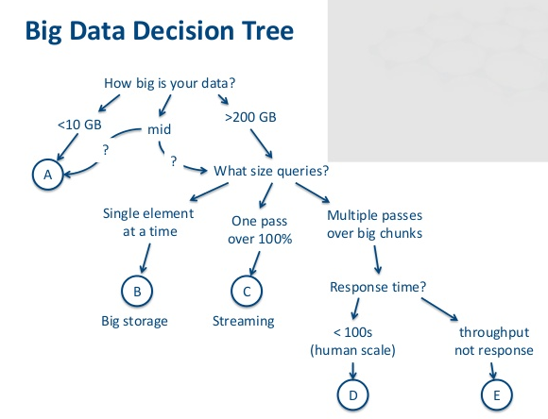
Machine Learning Algorithms – used to identify patterns
Supervised Learning
Decision Trees – initial object models were built after analyzing customer data, transaction and classifications
Unsupervised Learning
Clustering Algorithm – Hierarchical Cluster was chosen since KMeans and Mixed clustering seemed not suitable & lengthy approach
Each customer transaction cluster has Customer master information, each month transaction information, the CASH credit limit for LOW, MEDUIM, HIGH using m * n matrix (where m = customer ID, n = customer & transaction Info)

Slide 6
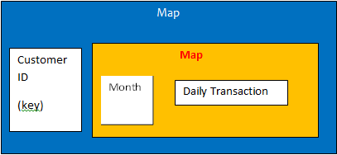
Data Visualization - Models
DailyTransaction (model)
creditCount
totalCredit (summation of amount in a month)
debitCount
totalDebit (summation of amount in a month)
totalCashDebit (summation of amount in a month)
totalCashCredit (summation of amount in a month)
CustomerCategory (model)
lowCustCreditLimit (low profile customer salary)
mediumCustCreditLimit (medium profile customer salary)
highCustCreditLimit (medium profile customer salary)
CustInfo (model)
customerName
salary
isFraud
profileCategory (LOW, MEDIUM, HIGH)
cashDebit (summation of amount)
cashCredit(summation of amount)
Pattern (model)
Holds criteria for demonetization like
Demonitization credit limits, etc.
Notes:
http://blog.aylien.com/naive-bayes-for-dummies-a-simple-explanation/

Slide 7
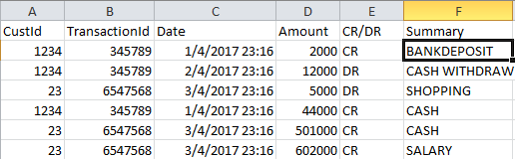
Algorithm - Dataset population
Generate dataset – master file, transaction file randomly using Precision & Recall technique
Dataset is pushed as a csv file for further processing

Slide 8
Algorithm – Dataset processing
Load into CustomerCategory object
Set criteria for fraud patterns
Read customer master file and load CustInfo object
Read transaction file & build inner level maps (clustering based on month for each customer)
Each month’s total credits, debits, cash credits, cash debits are calculated
CustInfo object gets updated with total cash credit , total cash debit
At position j , i.e., Nov ‘17 and above validation against total cash debit against the monthly cash credit is checked to identify frauds
This total cash debit varies with each customer & assumed to have an increase with small percentage as return on investment.

Slide 9
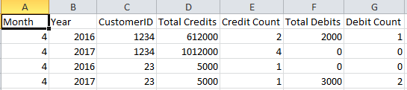

Data Visualization - Reports
2 reports are generated
Monthly report containing details on monthly transaction of each customer
Fraud alert report containing the customer detail & if there are fraud/not

Slide 10
Test scenarios probability considered
Customer CASH CREDIT with no past DEBIT history.
Customer CASH CREDIT post Demonetization whose cash credit amount is crossing 1.1, 1.15, 1.2 times of his overall Debit.
Inter bank transaction also added to Cash Debit
Customer with NO FRAUD dataset.
Customer once being identified as FRAUD is not reset to FALSE.
Customer doing more CASH CREDIT but not crossing the THRESHOLD limits

Slide 11
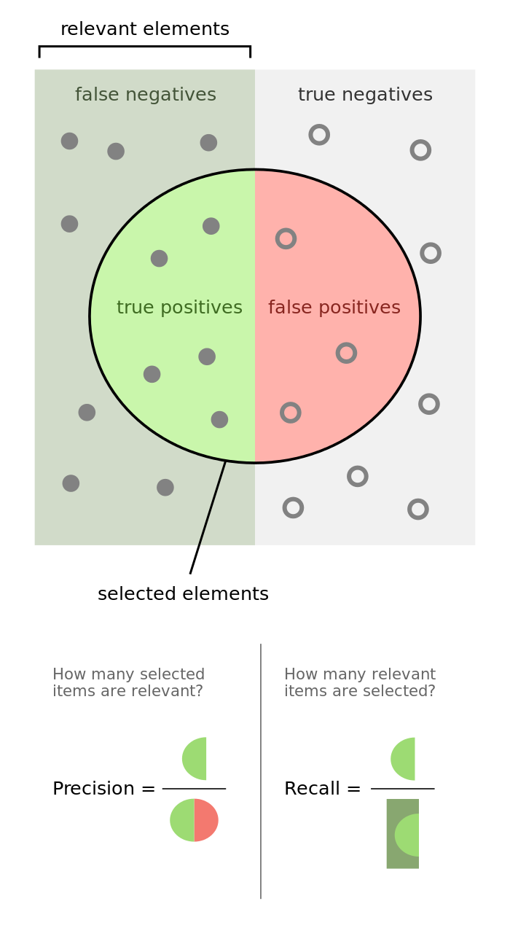
Test scenarios probability considered

